Slide 1

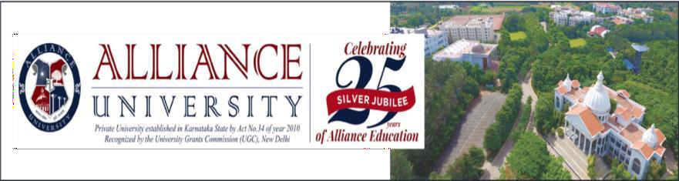
Crowd Sense
Team Members:
Hariduthram PS - 2023BIFT07AED006
S D Kowshik Raj - 2023BIFT07AED009
S Hareehareen Heidenreich - 2023BIFT07AED018
Subhi J - 2023BIFT07AED012
Name of the Mentor: Dr.Ummadi Janardhan Reddy
6IT1991 Design Project -2

Slide 2


Agenda
Introduction
Review of literature
Observations from the literature review
Limitations from the literature review
Problem Definition & Proposed Methodology
Problem Statement
Proposed Research / Methodology
Hardware Requirements
Software Requirements
References
Plagiarism Report

Slide 3
Introduction
Enhances safety and emergency response at large-scale events like concerts, sports
matches, and festivals.
Integrates wearable health bands to continuously monitor heart rate and SpO₂ levels of attendees.
Enables early detection of abnormal health conditions and triggers real-time alerts in emergencies.
Provides precise location tracking for rapid medical assistance.
Offers real-time crowd density analysis and visual dashboards for organizers.
Combines AI analytics with IoT-based health tracking to create a smart, responsive, and health-aware system.

Slide 4
Review of literature
S.No | Author | Research/Method ology | Performance Metrics | Advantages | Disadvantages
1 | Bh. Prashanthi | AI-driven wearable IoT health monitoring using CNN, LSTM, Random Forest & SVM with cloud-based predictive analytics | Prediction accuracy (~96%), response time (<3 sec), processing efficiency | Real-time monitoring, early disease prediction, remote healthcare support | Data privacy issues, interoperability challenges, cloud dependency
2 | Suraj Gupta | IoT wearable system with machine learning for continuous physical and emotional health monitoring with anomaly detection | Validation accuracy (~85%), sensitivity, specificity, F1-score | Personalized feedback, stress detection, proactive health alerts | Performance variation in dynamic conditions, battery limitations
3 | Caroline Abreu | Review-based study on wearable biosensors for continuous physiological and biochemical monitoring | Sensor reliability, monitoring capability, clinical feasibility | Continuous monitoring, preventive healthcare, non-invasive sensing | Privacy concerns, lack of standardization, integration challenges

Slide 5
S.No | Author | Research/Method ology | Performance Metrics | Advantages | Disadvantages
4 | Arnab Abhijit Chaudhuri | IoT-based cloud-integrated health monitoring system using ESP32, contactless IR temperature sensor and PPG pulse sensor with adaptive filtering & cloud platforms (Blynk, ThingSpeak) | Temperature accuracy (±0.3°C), heart rate accuracy (within 2–3 BPM), real-time cloud response | Contactless monitoring, real-time remote access, low-cost portable design, accurate signal processing | Motion noise affects pulse readings, requires Wi-Fi connectivity, limited parameters
5 | Surya Narayanan | AI-based crowd management system using machine learning, computer vision and real-time video analytics to monitor crowd density, predict behavior and support emergency response in smart public spaces | Tracking accuracy, prediction accuracy, system latency, response efficiency | Improves public safety, real-time crowd monitoring, supports early hazard detection and evacuation planning | Requires high computational resources, privacy concerns with video surveillance, performance depends on camera quality & network stability

Slide 6

Observations from the Literature Review
Most existing systems address crowd management and health monitoring as separate solutions.
Wearable health monitoring enables real-time data collection but faces battery and
connectivity challenges.
AI models provide accurate anomaly detection but demand high computational power.
There is a lack of integrated systems combining real-time health tracking, crowd
density visualization, and intelligent navigation in one unified platform.

Slide 7
Limitations from the Literature Review
Most studies focus on isolated aspects like crowd control or health monitoring, not an integrated system.
Wearable devices face battery drain and connectivity issues during continuous monitoring.
AI models for anomaly detection demand high computational power, affecting real-time performance.
There is a lack of real-time coordination between health data, crowd analytics, and emergency response mechanisms.

Slide 8
Problem Statement
Managing large crowds and ensuring attendee safety is a major challenge during large-scale events.
Existing systems focus separately on crowd management, navigation, or health monitoring.
Lack of integration leads to delayed emergency response and inefficient coordination.
The project aims to develop an AI-powered system combining wearable health
tracking, real-time crowd analysis, and location-based emergency response.
The solution ensures a safer, smarter, and more responsive event environment.

Slide 9
Proposed Idea
Develop an AI-powered system that integrates wearable health bands to monitor
attendees’ heart rate and SpO₂ in real time.
Use AI-based anomaly detection to identify abnormal health conditions automatically.
Trigger instant emergency alerts and share location details with on-site medical teams for rapid response.
Implement real-time crowd density visualization to prevent overcrowding and
enhance situational awareness.
Create a centralized dashboard for event organizers and medical staff to monitor overall safety and coordinate responses efficiently.

Slide 10

Objectives of the Idea
To monitor real-time heart rate and SpO₂ of attendees using wearable devices.
To detect abnormal health conditions through AI-based anomaly detection.
To trigger instant emergency alerts and provide accurate location tracking for quick medical response.
To analyze crowd density for preventing overcrowding and improving safety management.
To design a centralized monitoring dashboard for organizers to oversee health and safety conditions effectively.

Slide 11
Proposed Research
Use ESP32-based wearable bands with MAX30102 sensors to collect heart rate and
SpO₂ data.
Transmit data via BLE beacons to local gateways, then forward to cloud servers.
Deploy AI models (XGBoost) to analyze vital signs and detect abnormal health conditions.
Implement a backend system (FastAPI + Firebase/PostgreSQL) to store data, manage alerts, and visualize crowd density.
Provide an event control center dashboard displaying real-time health monitoring, crowd density heatmaps, and emergency notifications.

Slide 12
Hardware Requirements
ESP32 microcontroller with MAX30102 sensors for heart rate and SpO₂
monitoring.
BLE beacons for transmitting data and supporting crowd density tracking.
Gateways for collecting data from wearables and sending it to cloud servers.
Smartphones or tablets (optional) for viewing dashboards or alerts by organizers/medical staff.

Slide 13
Software Requirements
XGBoost – for AI-based health anomaly detection.
FastAPI – backend framework for data handling and alert management.
Firebase / PostgreSQL – cloud database for storing health and crowd data.
Dashboard/Visualization Tools – for real-time crowd density heatmaps and emergency notifications.
Optional Mobile App – for organizers/medical staff to monitor health data and receive alerts.

Slide 14
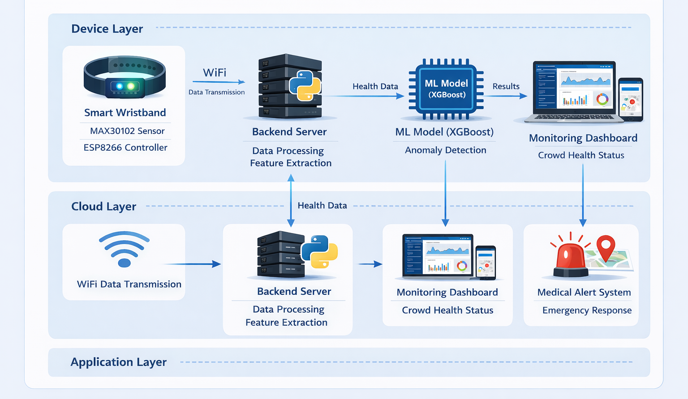
Architecture

Slide 15
Proposed Modules
Wearable Health Monitoring Module
ESP32 bands with MAX30102 sensors collect heart rate and SpO₂ data in real
time.
Data Transmission Module
BLE beacons transmit data to local gateways, which forward it to cloud servers.
AI-Based Health Analysis Module
TensorFlow Lite models analyze vitals to detect abnormal conditions
automatically.
Emergency Alert Module
Generates instant alerts with the location of affected individuals for rapid medical
response.
Crowd Monitoring & Visualization Module
Displays real-time crowd density heatmaps and health status dashboards for organizers and medical teams.

Slide 16
Novelty of the Proposed Idea
Integrated Approach: Combines wearable health monitoring, AI-based anomaly detection, and real-time crowd management in a single system.
Proactive Emergency Response: Automatically detects health issues and alerts medical teams instantly with precise location tracking.
Real-Time Crowd Insights: Provides live crowd density visualization, enabling organizers to prevent overcrowding and manage events efficiently.
IoT & AI Synergy: Leverages ESP32-based wearables and lightweight AI models for efficient, low-latency monitoring.
Scalable & Flexible: Can be deployed in concerts, sports events, festivals, or any large public gatherings.

Slide 17
Conclusion
The proposed AI-powered Crowd Management & Health Monitoring System ensures real-time monitoring of attendees’ health during large-scale events.
It enables instant detection of abnormal conditions and triggers rapid emergency response with precise location tracking.
By combining wearable IoT devices, AI analytics, and crowd density visualization, the system enhances safety, efficiency, and situational awareness.
The project offers a scalable, integrated solution for safer and smarter
management of public gatherings.

Slide 18
References
Authors, Year, Title of the Paper, Journal / Conference, Volume and Page Details, DOI (Samples are given below)
Kong, W., & Agarwal, P.P. (2020). Chest imaging appearance of COVID-19 infection. Radiology: Cardiothoracic Imaging,
2(1).
Li, Y., & Xia, L. (2020). Coronavirus Disease 2019 (COVID-19): Role of chest CT in diagnosis and management. American Journal of Roentgenology, 1–7.
Mooney, P. (2020). Kaggle chest x-ray images (pneumonia) dataset, https://github.com/ieee8023/covid-chestxray-datase
Parnian Afshar., Shahin Heidarian., Farnoosh Naderkhani., Anastasia Oikonomou., Konstantinos, N. Plataniotis., & Arash
Mohammadi. (2020). COVID-CAPS: A capsule network-based framework for identification of COVID-19 cases from X-ray
images, Pattern Recognition Letters, 138, 638–643
Singhal, T. (2020). A review of corona virus disease-2019 (COVID-19). Indian Journal of Pediatrics, 87, 281– 286.

Slide 19
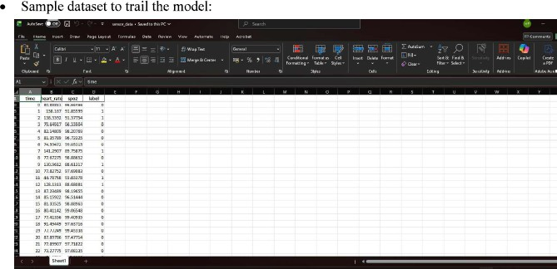
Partial Implementation

Slide 20
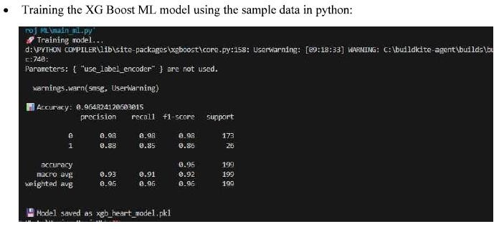
Partial Implementation

Slide 21
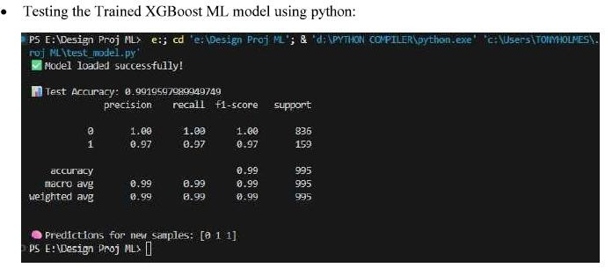
Partial Implementation

Slide 22
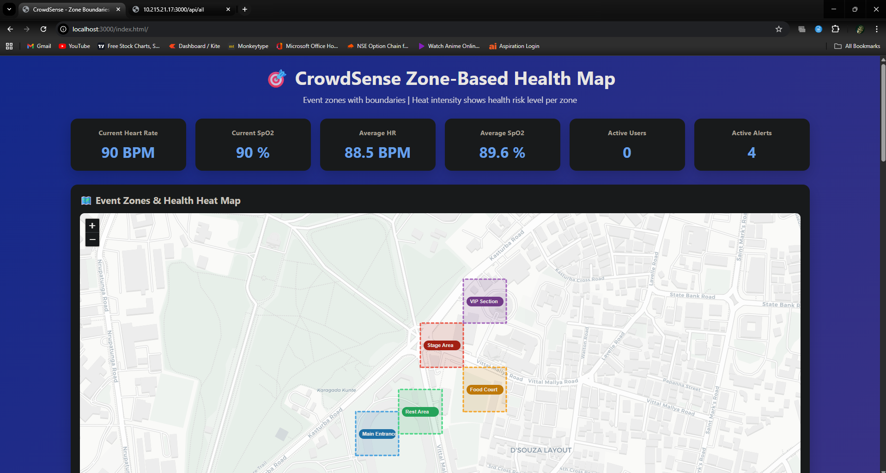
Implementation

Slide 23
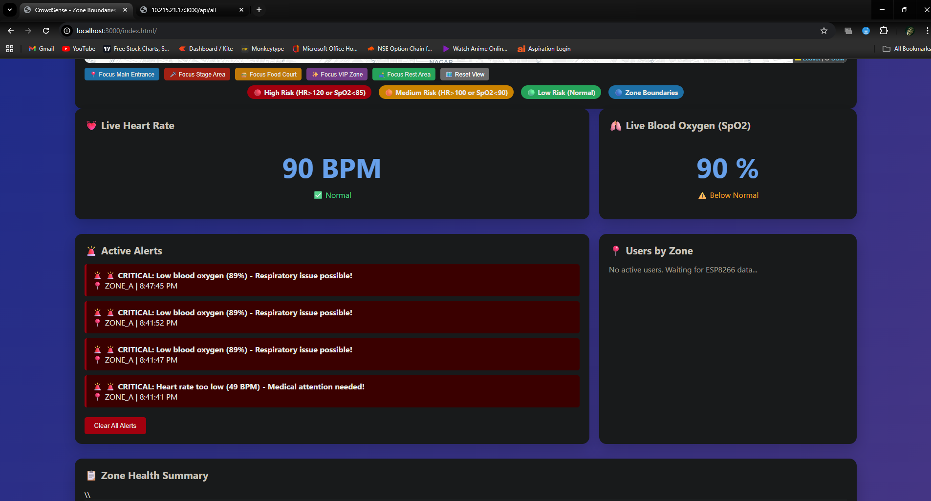
Implementation

Slide 24
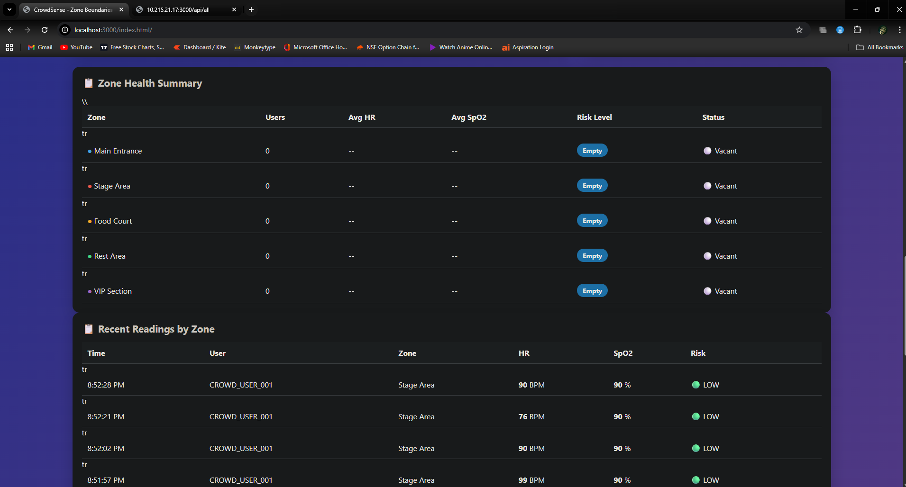
Implementation

